Slide 1

ONLINE SHOPPING

Slide 2
What is online Shopping
Online shopping is a form of electronic commerce which allows consumers to directly buy goods or services from a seller over the Internet using a web browser

Slide 3
Online Shopping
Introductions
The Name of the project is Online Shopping.
This Document provides details about the entire software requirement specification for the software E-Shopping a database for online shopping centre.
The Purpose of this project is to provide easy shopping facility online and easy selling facility to the merchants of all categories.

Slide 4
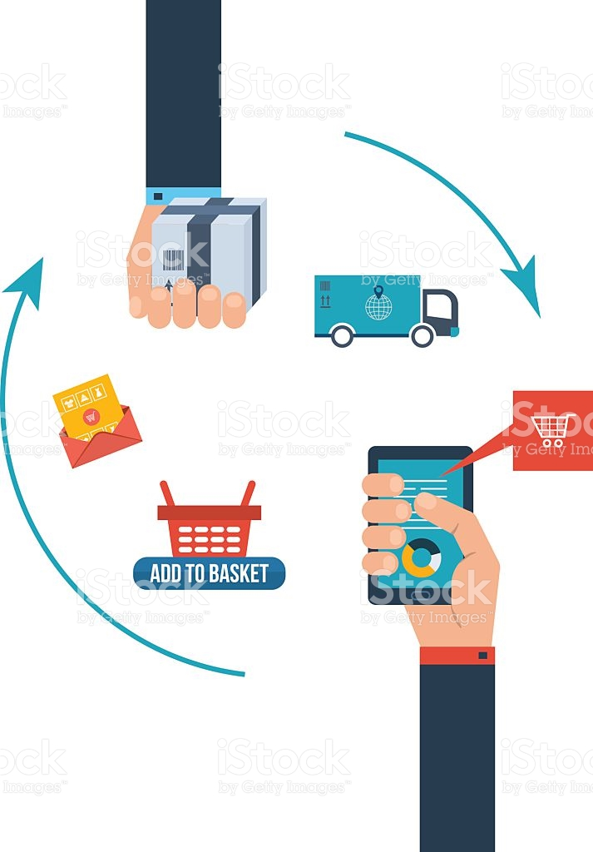
Process of Online Shopping

Slide 5
Consumer Benefits
Convenience
- Geographic
- Store hours (24*7)
- Quick and efficient shopping process
Information
- Quick location of items
- Easy price/attribute comparisons

Slide 6
Risks & Disadvantages of Online Shopping
Fraud - Do you know the Company?
Security - Is your credit card safe?
Privacy - Is your information being sold?
Shipping - Are you getting the correct product at
the requested time?
Difficulty - Do you know how to shop online?

Slide 7
Online Shopping VS Traditional Shopping
Differences:
- Cannot try or test product before purchase.
- Minimum human interaction.
- Shop anytime online and from anywhere. There is no boundary limit on purchasing.

Slide 8
Software Requirements
Operating system : Windows 7
Development platform : Dreamweaver
Language : PHP, MySQL, HTML, CSS, JQUERY, JAVASCRIPT
Server : XXAMP(Apache)
Browser : Google Chrome

Slide 9
Hardware requirements
CPU : Intel dual core , 3.0 GHz DDR3
RAM : 2GB
HDD : I TB
Monitor : Colour monitor

Slide 10
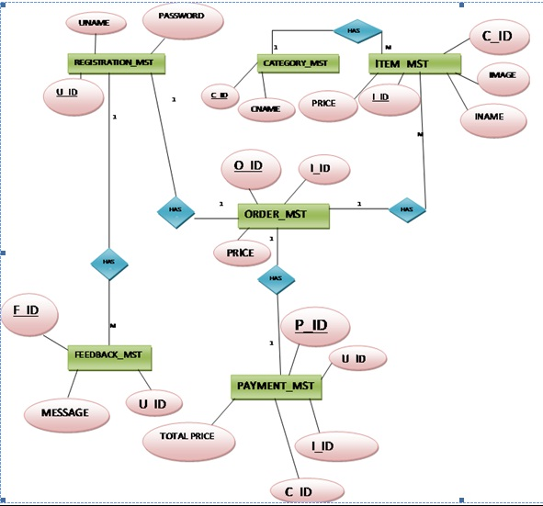
E R Diagram

Slide 11


